Slide 1

SAP BTP ABAP on Cloud / RAP Training
DAY-6
Anubhav Oberoy
www.AnubhavTrainings.com
Follow excellence with sheer passion

Slide 2


DISCLAIMER
The training content and delivery of this presentation is confidential, and cannot be recorded, or copied and distributed to any third party, without the written consent of Anubhav Trainings

Slide 3

01
RAP Actions
Working with actions in RAP framework
02
Behavior Pool
Understanding Behavior Implementation
03
Early Numbering
Generate numbers automatically
04
RAP Actions
Working with actions in RAP framework
Notes:
https://pixabay.com/photos/san-francisco-transamerica-pyramid-1633203/

Slide 4

Development Flow – Processor and Approver
Fiori App – Processor
Create, update, delete, copy travel
Fiori App – Approver
Display the travel request data
Service definition
Service Binding
Service definition
Service Binding
MDE for Processor Projection
MDE for approver Projection
BDEF Projection
For Processor
Expose what is needed by a processor role in company
Behaviour Definition (BDEF)
Tell RAP framework regarding our operations which needs to be supported for BO (managed)
BDEF Projection
For Approver
Expose what is needed by a approver role in company
Business Object Projection
For Processor
30 fields to internet
Business Object (definition)
Includes the Travel, Booking and Booking Supplement CDS entities
100 fields
Business Object Projection
For Approver
25 fields
www.anubhavtrainings.com

Slide 5

Data Actions in RAP
In the context of RAP, an action is a non-standard operation that change the data of a BO instance or create new BO instances. They are self implemented operations. There are two main categories of data actions can be implemented in RAP:
Non factory action: Defines a RAP action which offers the non-standard behavior and implement custom logic in handler with MODIFY clause. A non factory action can be of 2 sub types (change a property of a record)
Static – they are not bound to any instance, they are generic and can be applied to all instances, like we want to change the booking fees for all travel request as fix price during promotion period.
Instance – An action that, by default relates to a BO RAP entity instance and changes the state of BO instance. E.g. like approve or reject a travel request where user choose a instance which they want to work with.
Factory Action – A factory action used to create new BO instances. A factory action can be instance-bound (default) or static.
Instance – that copy specific values of an instance and create new instances based on copied data
Static – can be used to create instances with prefilled default values
www.anubhavtrainings.com

Slide 6















Slide 7






































Slide 8









Slide 9
Determination
A determination modifies instance of business object based on trigger condition. Trigger condition can be modify operations such as create, update, and delete and modified field. There are 2 types of determination
on modify – will be triggered before save whenever trigger condition is met e.g. when I change booking fee
on save – will always trigger at the time of save
Steps
Add the code for defining the determination in behavior definition, we want to do it in reusable way
Use quick fix to generate the code for determination
Define a structure where we can store all the booking fees and currency code
Read all travel instances, subsequent bookings using EML
Total all booking and supplement amounts which are in common currency
Delete the values w/o any currency
Loop at all amounts and compare with target currency
Perform currency conversion
Put back the total amount
Return the total amount in mapped so the RAP will modify this data to DB
www.anubhavtrainings.com

Slide 10

































Slide 11
Validations
Many times we would like to perform business specific checks in our application, The rap framework is only responsible to perform CURDQ operations. It does not know what are all the business rules applies to our code.
If we return FAILED and MESSAGE then the RAP will terminate the update/create and shows the message to the user on Fiori App.
www.anubhavtrainings.com

Slide 12
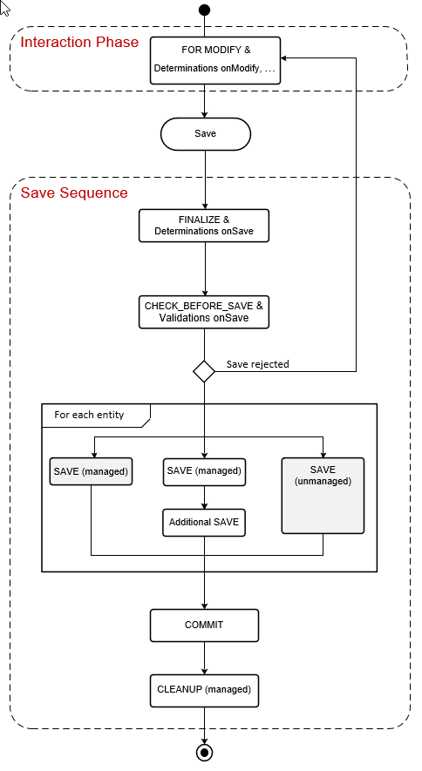
www.anubhavtrainings.com

Slide 13
Side Effects
Side effects are useful in UI scenarios based on BO which makes the Fiori element UI know/aware about the data changes in backend. Whenever data is reevaluated in backend, the frontend is unaware of that, we need to make sure that the frontend make a forceful call to GET the data back on UI.
The Fiori UI will never make an unnecessary call to perform a round trip. If we know that, a change in a field would certainly change the data in SAP system, we need to inform the same to RAP BO, so that it can make a GET call to reload the particular field value and display the updated data on UI. E.g. when we change the booking fee, or flight price under booking table, we need to reload the total price (which is getting calculated in backend using determination), this is exactly what the side effect can do for us.
www.anubhavtrainings.com

Slide 14

Draft
Draft is a very important functionality of an enterprise application, which allows us
To create a stateful application from stateless
Store intermediate data in sap system
Perform validations on-fly, increases the collaboration with our app
Device switch
The Odata V4 never allow CURD operation without having draft feature to your BO
www.anubhavtrainings.com

Slide 15
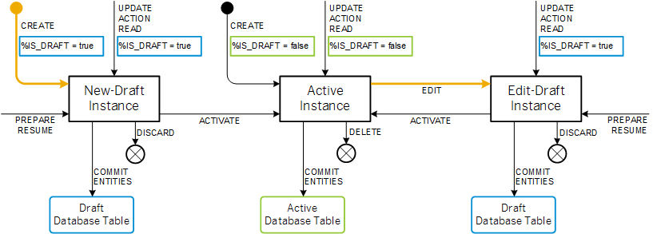
Draft Runtime
www.anubhavtrainings.com

Slide 16
Solution for draft issue – Short Dump
<>
www.anubhavtrainings.com

Slide 17
Additional Save
In some application scenario, an external functionality must be invoked during save sequence, after the managed runtime has gathered the changed data of business object’s instance, but before final commit work has been executed.
For example, reuse services like change documents and application logging/tracing must be triggered during save sequence and changes the current transaction in a change request or logging table.
www.anubhavtrainings.com

Slide 18
Authorization
Authorization control in RAP protects our business object against the unauthorized access of data. Authorization control is always relevant when the permission to execute an operation depends on a role of BO consumer. In the RAP, each read or modify request can be checked via authorization object against the user role before the request is finally executed and reaches data.
The auth check with auth object is called from cds entities in case of read request – was covered in Anubhav trainings abap on hana course
And behavior implementation in case of modify request
Global authorization
Global authorization is used for all authorization checks that only depends on the user.
Global authorization checks can be implemented both for static and instance bound operations
Instance authorization
Instance authorization is used for all auth checks that, in addition to the user role, depend on the state of the entity instance in question (like exact record level). Its only possible for instance based operation
Operations that are executed from instance auth are CREATE and static actions
Use case: when a user tries to edit a travel request, if the travel request status is cancelled, then we need to check that if he/she is a manager or not. Only managers can edit a cancelled travel request. Since each travel request is different, we need to go with instance-based authorizations.
www.anubhavtrainings.com

Slide 19
Prechecks
While the system is saving the draft in the draft table we can use prechecks to make sure that checks/authorizations are checked in the system before data reaches to draft table. Unlike validations (while saving/updating data to main table) Prechecks will trigger before data reaches to transaction buffer.
They are very helpful when we even want to validate data of one control based on another control. Currently as a developer you need to take additional pain to clean the data when draft is activated. If you apply precheck, system ensures that only the clean data reaches to transaction buffer.
www.anubhavtrainings.com

Slide 20
Augment
Before data reaches to transaction buffer, the augment code will be executed and here we can set some default data to the BO instance.
www.anubhavtrainings.com

Slide 21
Virtual Elements
There is a requirement to expose extra elements out of cds entities for which there is no data inside the database, basically these element values are calculated at runtime (on-fly). If you worked with SAP UI5 development, we have similar concept called formatter. We have a implementing class in which we will add our code for calculating the runtime data of virtual elements.
Rules:
We should only add them to projection view. Because if you add in main view, your draft table will disturb and your main table will never have these column.
RAP does not support filtering and sorting of virtual elements, also the aggregation and group is not allowed
We cannot select data from virtual elements using direct SELECT or EML
We have to write implementation in a class for virtual element that class must use the interface IF_SADL_EXIT_CALC_ELEMENT_READ.
www.anubhavtrainings.com

Slide 22
Steps to implement the approver scenario
Go to base behavior definition and add non factory actions, provide implementation for the same
Create copy from processor cds entity projections and make new cds entities for projection for approver. Both travel and booking, ignore the booking supplement as a approver will only allowed to view upto the booking data.
Create metadata extensions for approver. Since approver can only see the data of travel and booking, we only created 2 MDE. Keep all the relevant fields and integrate code to show accept and reject travel buttons.
Now we provide behavior definition projection for approver which controls what an approver can do. As we know an approver can only edit bookingfee and travel status, he/she not allowed to create/update/delete any of the entities.
Customize our BDEF according to the needs of our user scenario.
Create a service definition for approver and service binding for approver.
Testing ☺
www.anubhavtrainings.com

Slide 23
Question
Currently you are testing the Fiori App by using the standard preview option in eclipse tool. Will our end user have the ability and skill to open eclipse tool, go to package and search BIMP and then open preview and that too in production system.
Business Application Studio – It is a multi cloud development tool which allows developers to build, test, package, deploy, and manage end to end Fiori applications.
SAP build work zone (aka cFLP in BTP) – it helps us to configure a site called Fiori launchpad in the cloud. All the Fiori Apps which you build in BTP will be accessed via this build workzone from end user. End user will get single URL, which contains the tiles for all our apps deployed in BTP.
Continuous Integration Service – When a developer change the application, and push to central repository like git, the CI service will automatically build and deploy our app.
Note:
All the Fiori apps which we create in BTP will be called MTA – Multi target application, they are deployed with mta.yml file. Which will contain the configuration for the Fiori App.
In SAP BTP, there is a storage space called html-5-repository where the BTP will store our Fiori apps.
When we deploy our app, there is html5-deployer which will take our app from BAS tool and deployes it to the HTML5 Repository (Design time)
When we run the app, there is a service called html5-rt (runtime) service which will load our app from the repository in the build workzone.
Apart from that the application will contain a connectivity service to communicate with our abap on cloud system.
And a destination service which will read the destination (RFC) of AOC system to access data in Fiori.
www.anubhavtrainings.com

Slide 24
www.anubhavtrainings.com
Thank You
End of Day 5
www.anubhavtrainings.com

Slide 25


We’re committed to empower you to be
#FutureReady
through powerful training solutions.
We build the workforce of the future.
250+
Corporate Clients
30,000+
Learners Trained
25000+
Learners Placed
FREE WEBINARS
Sign up for free webinars with industry experts every fortnight!
Enroll Now!
Contact us today!
https://anubhavtrainings.com

